Slide 1
GSM-BASED BOREWEL WATER LEVEL MONITOR
Project Group:
    Bhagora Dharmendra J. 106500309079
    Patel Dishank S. 096500309098
    Jayswal Jignesh p. 106500309086
Guided By:
    Pro.HVM.

Slide 2

GSM-BASED BOREWEL WATER LEVEL MONITOR
PREPARED BY GROUP : G
GUIDED BY :
PROF. H.V.M
BHAGORA DHARMENDRA J.
PATEL DISHANK S.
JAYSWAL JIGNESH P.
SWAMI SACHCHIIDANAND POLYTECNIC COLLAGE, VISNAGAR

Slide 3
Flow of presentation
1 Introduction
2 Features
3 Circuit diagram
4 Circuit Description & Working
5 Component List
6 Application of Project

Slide 4
INTRODUCTION
If the water level in a borewell drops below the threshold level for pumping, its pump motor may get air-locked or even burn out due to dry running. It is inconvenient for farmers to walk all the way to their fields at night just to switch the pump motor ’off’. Besides, he may never get to know the problem.

Slide 5
This problem can be solved by using this GSM-based system that will automatically give the user a call on his mobile phone when the water level in the borewell drops below or rises to the threshold level for pumping.
The user can also remotely switch on or switch off the pump motor by sending an SMS from his mobile phone. The system is simple, reliable, portable and affordable.

Slide 6
FEATURES
Provides serial TTL interface for easy and direct interface to microcontrollers
Power Indicator LED for easy debugging
Can be used for GSM based Voice communications, Data/Fax, SMS,GPRS and TCP/IP stack
Can be controlled through standard AT commands
Comes with an onboard wire antenna for better reception. Board provides an option for adding an external antenna through an SMA connector
The SIM300 allows an adjustable serial baudrate from 1200 to 115200 bps

Slide 7
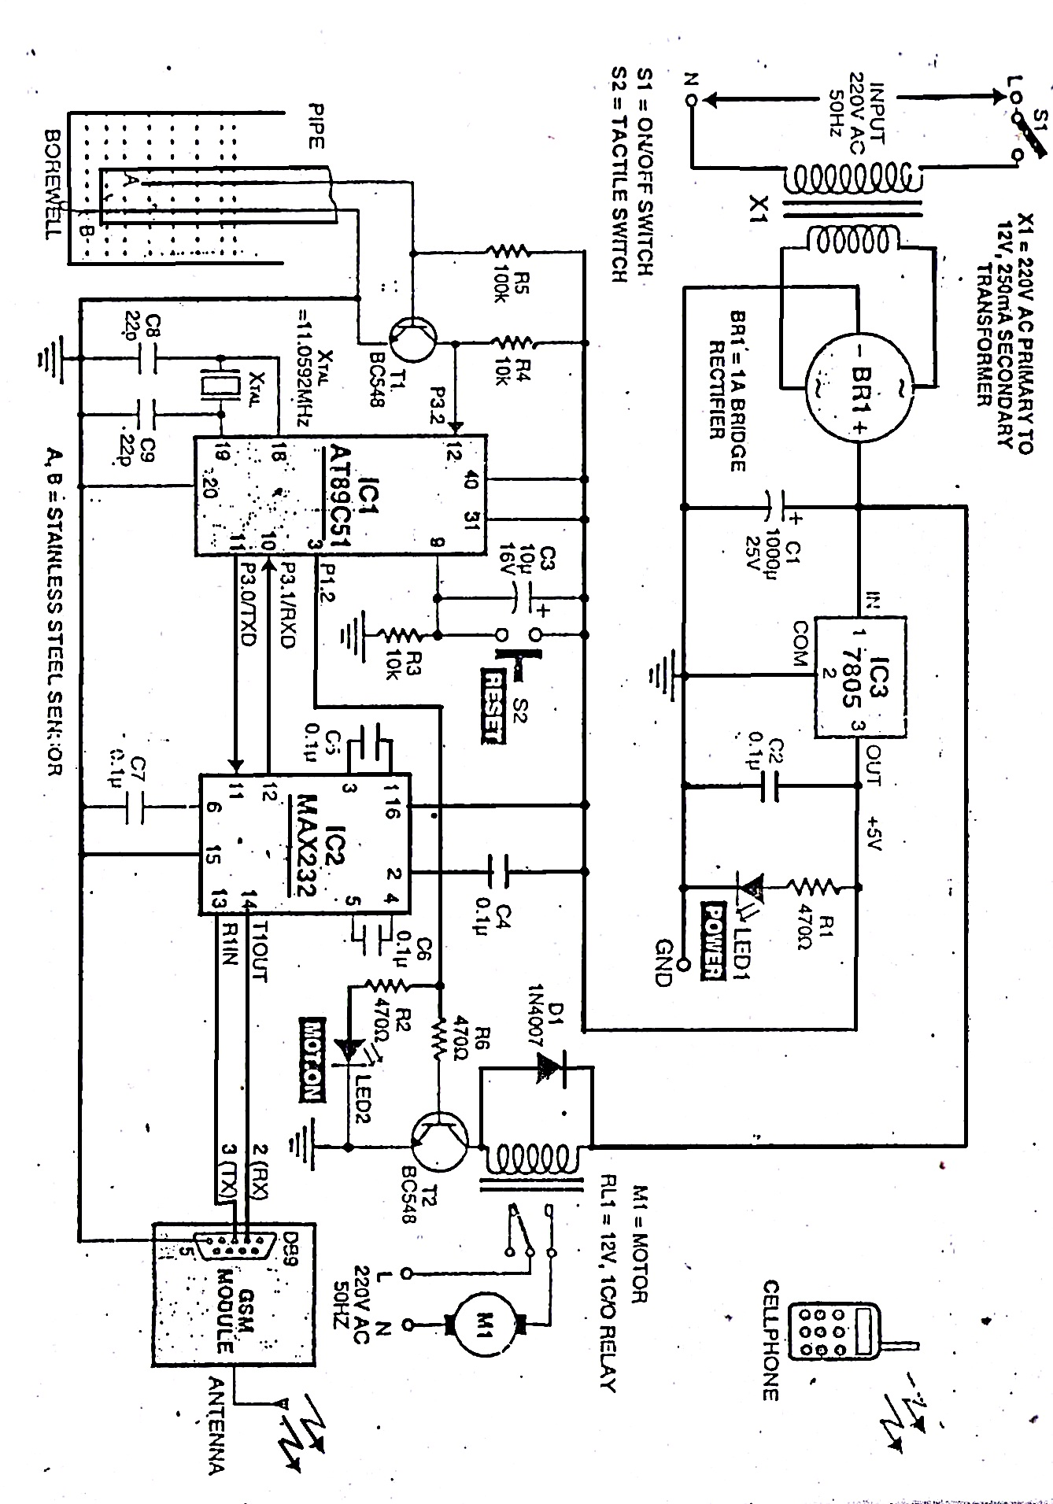
BLOCK DIAGRAM

Slide 8
Circuit Description & Working
GSM-based monitor is shown in block diagram. It comprises the power supply section, sensor circuit, microcontroller, MAX232 driver, relay driver & GSM-modem. The GSM board has a valid SIM card with sufficient recharge amount to make outgoing calls.
The circuit is powered by regulated 5V DC. The 220V/AC mains is stepped down by transformer X1 to deliver a secondary output of 12V,250mA. The transformer output is rectified by bridge rectifier BR1, filtered by capacitor C1 and regulated by IC-7805. Capacitor C2 bypass ripples from the regulated power supply . LED1 acts as the power-‘on’ indicator.

Slide 9
When water level in the borewell dips below sensors A and B breaks. Hence a signal is received by the microcontroller. The microcontroller turns the running motor ‘off’ and makes a call to the user’s cellphone through GSM-modem to indicate that sensing is not connected to on the relay is switched off in this way the device is protected from damage the status of motor level and LED2 are shown in table1. The GSM-modem used in this project is SIM300/V7.03.

Slide 10
Components List
IC1 -AT89C51 microcontroller
IC2 -MAX232 driver
IC3 -7805,5V regulator
BR1 -1A bridge rectifier
T1,T2 -BC548 NPN transistor
LED1,LED2 -5mm led
D1 -1N4007 rectifier diode
R1 -1K ohm

Slide 11
R2,R6 -470 ohm
R3,R4 -10K ohm
R5 -100K ohm
C1 -1000µF/25V
C2,C4-C7 -0.1µF
C3 -10µF/16V
C8,C9 -22pF
RL1 -12v,relay
Crystal -11.0592MHz
GSM-modem -SIM300 V7.03 modem

Slide 12
Application of Project
GSM Based Monitor Controller for Hotels, Factories, Homes Apartments, Commercial Complexes, Drainage, etc., It can be fixed for single phase motor, Single Phase Submersibles, Three Phase motors. & open well, Bore well and Sump. Many models available in different ranges.

Slide 13
Thank You

